Slide 1




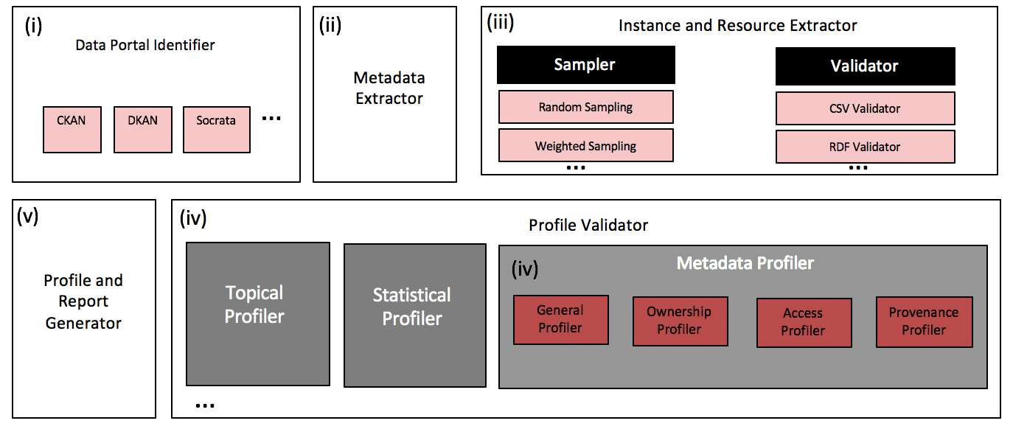
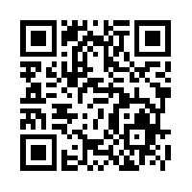
Roomba
Automatic Validation, Correction and Generation of Dataset Metadata Enhancing Dataset Search and Spam Detection
Ahmad Assaf†, Raphaël Troncy† and Aline Senart‡
†EURECOM
Sophia Antipolis, France
firstName.lastName@eurecom.fr
‡ SAP Research, SAP Labs France SAS
Mougins, France
aline.senart@sap.com
Data Portals
A curated collection of metadata about datasets providing discovery functionality to complement conventional browse-style catalogue interfaces
General information
e.g. title, description
Ownership information
e.g. author, maintainer_email
Access information
e.g. license_title, license_id
Provenance information
e.g. creation_date, version
Running Roomba on the LOD Cloud✝ group on the Datahub (259 Datasets)
41%
of the ownership information is missing
64%
of the resources metadata is missing
44%
of the top metadata problems fixed automatically
All results are reproducible from our code base at https://github.com/ahmadassaf/opendata-checker
This research has been partially funded by the European Union's 7th Framework Programme via the project Apps4EU (GA No. 325090)
✝ http://datahub.io/group/lodcloud

